Slide 1
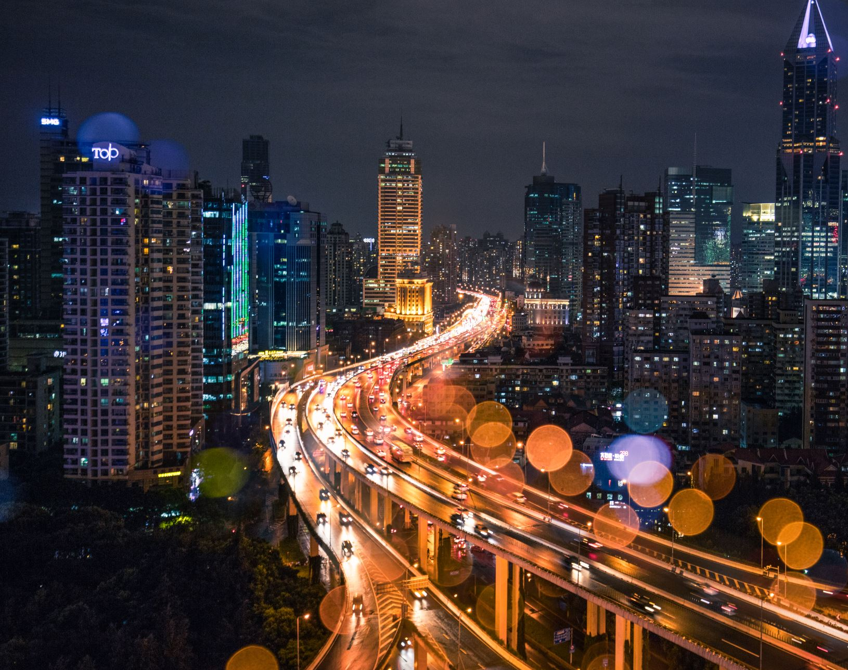
Traffic Sign Recognition System
Presented by:
Jasleen Kaur
Komal Astawala
Mayankkumar Patel
Simran
Shreeprada devaraju

Slide 2
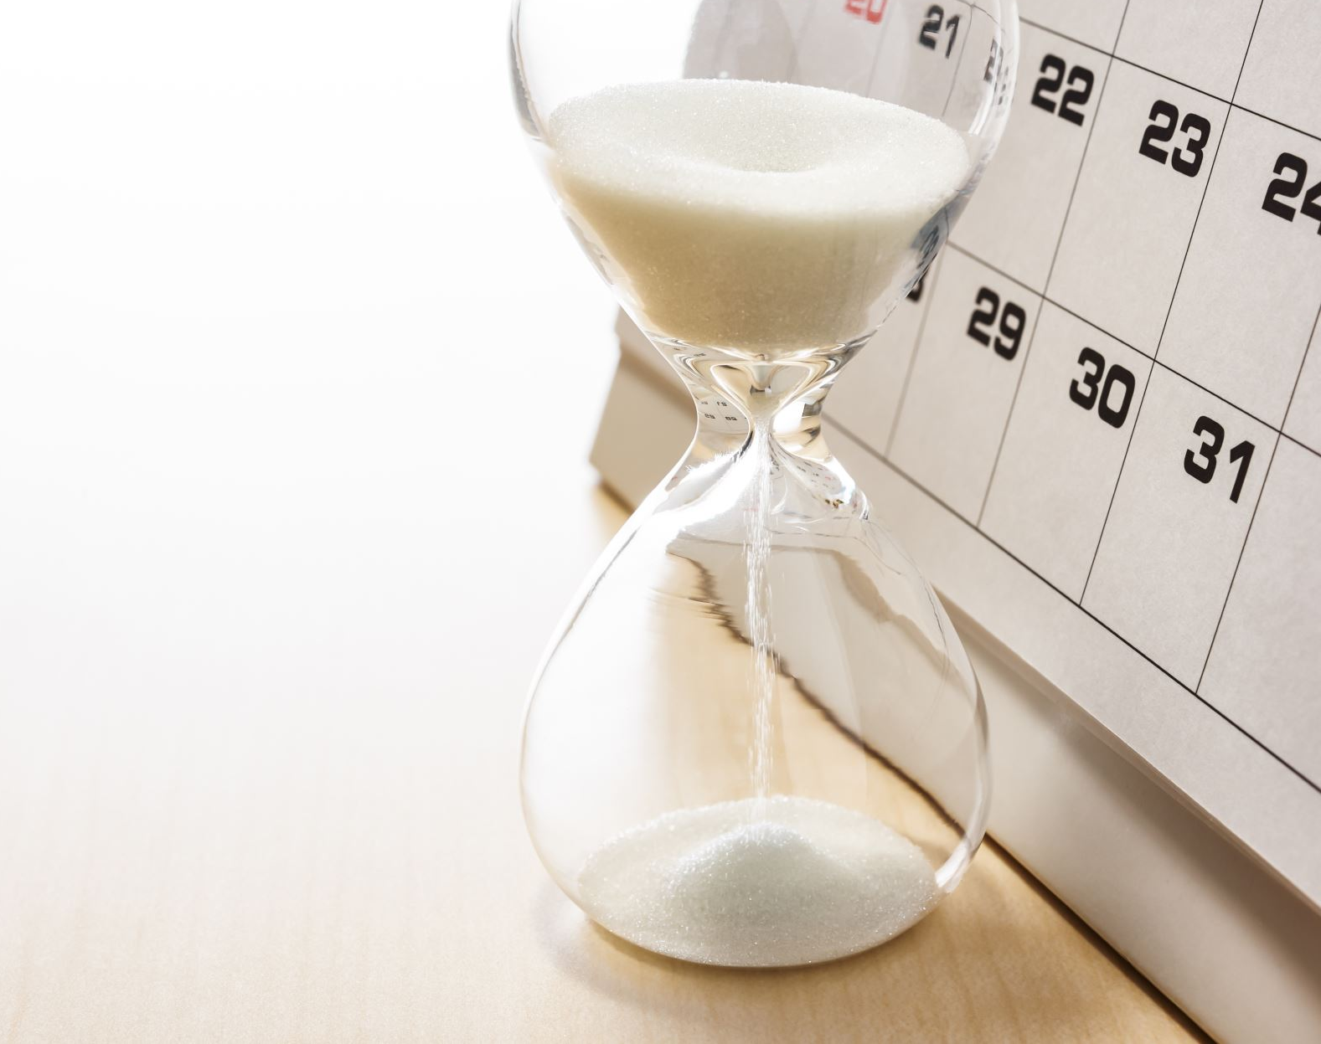
Agenda
Introduction
Introduction to Dataset
Data Pre-Processing
Model Implementation
Model Tuning
Discussion
conclusion

Slide 3
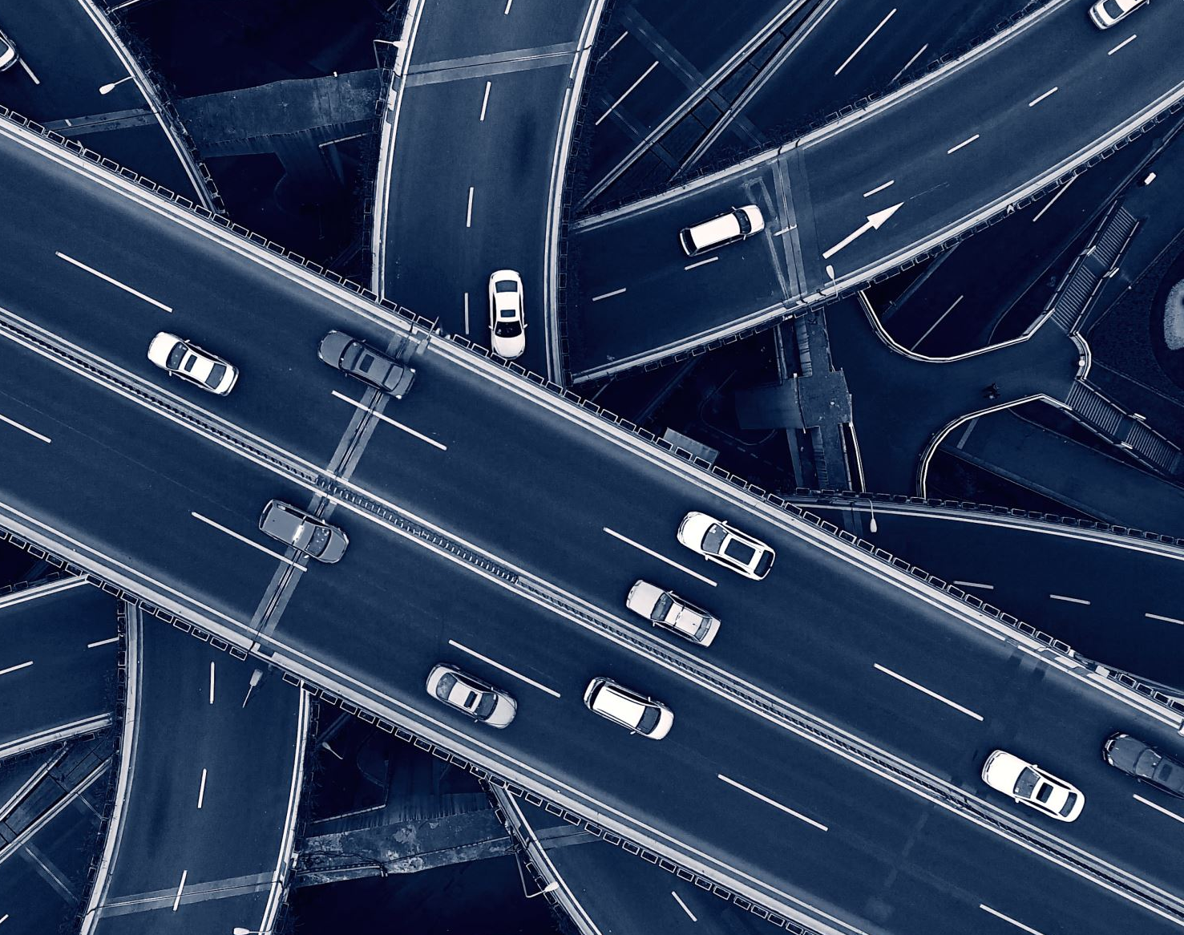
Introduction
Problem Statement:
Development of a deep learning system using Python and Keras to accurately classify traffic signs from images.
Significance:
Automation of the recognition of traffic signs, which is essential for autonomous vehicles and advanced driver-assistance systems (ADAS).

Slide 4

Dataset: German Traffic Sign Recognition Benchmark (GTSRB)
Source: Kaggle
Metadata
43 distinct classes comprise almost 50,000 photos of various traffic sign types in the dataset utilized for this study.
The collection contains images in four colors (0-red, 1-blue, 2-yellow, 3-white) and five sizes (0-triangle, 1-circle, 2-diamond, 3-hexagon, 4-inverse triangle).
Introduction to Dataset

Slide 5

Data Preprocessing
Image Count Reduction:
Raw data has 43 unbalanced folders of different images.
To create balanced dataset, every folder content size was reduced to have 500 images
For folders having less than 500 images, augmentation techniques were used

Slide 6
Data Preprocessing
Image Augmentation:
Image Rotation: Rotating an image around its center by a specified angle.
Image Flipping: Mirroring an image horizontally or vertically.
Image Translation: Shifting an image in horizontal and vertical directions.
Brightness Adjustment: Altering the brightness level of an image.
Image Shearing: Distorting an image by shifting one side relative to the other.
Image Gray scaling: Converting a color image into grayscale, removing color information.

Slide 7
Model Implementation
Convolutional Neural Network (CNN) Architectures implemented:
VGG16
LeNet-5
Inception
RestNet50
CustomModel

Slide 8
Model Implementation (Phase – 1)

Slide 9
Model Implementation (Phase – 2)

Slide 10

Model Evaluation

Slide 11
Test Accuracies (Custom vs ResNet50)
The accuracy of the custom TSR model is slightly higher than the ResNet50 model (around 0.84 compared to 0.81).

Slide 12
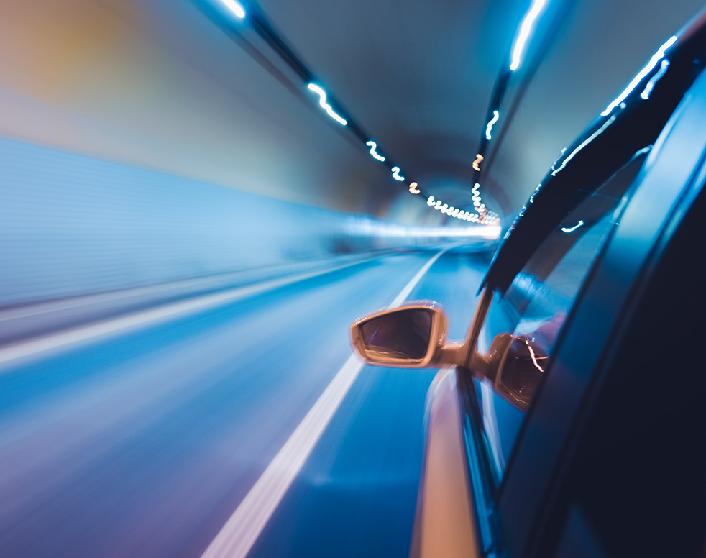
Custom Model with L2 Regularization
To address overfitting in our custom mode, L2 regularization was implemented
The model's accuracy remained at 39.55%.
Suggests that while overfitting may have been mitigated to some extent, other factors may be contributing to the model's performance.

Slide 13
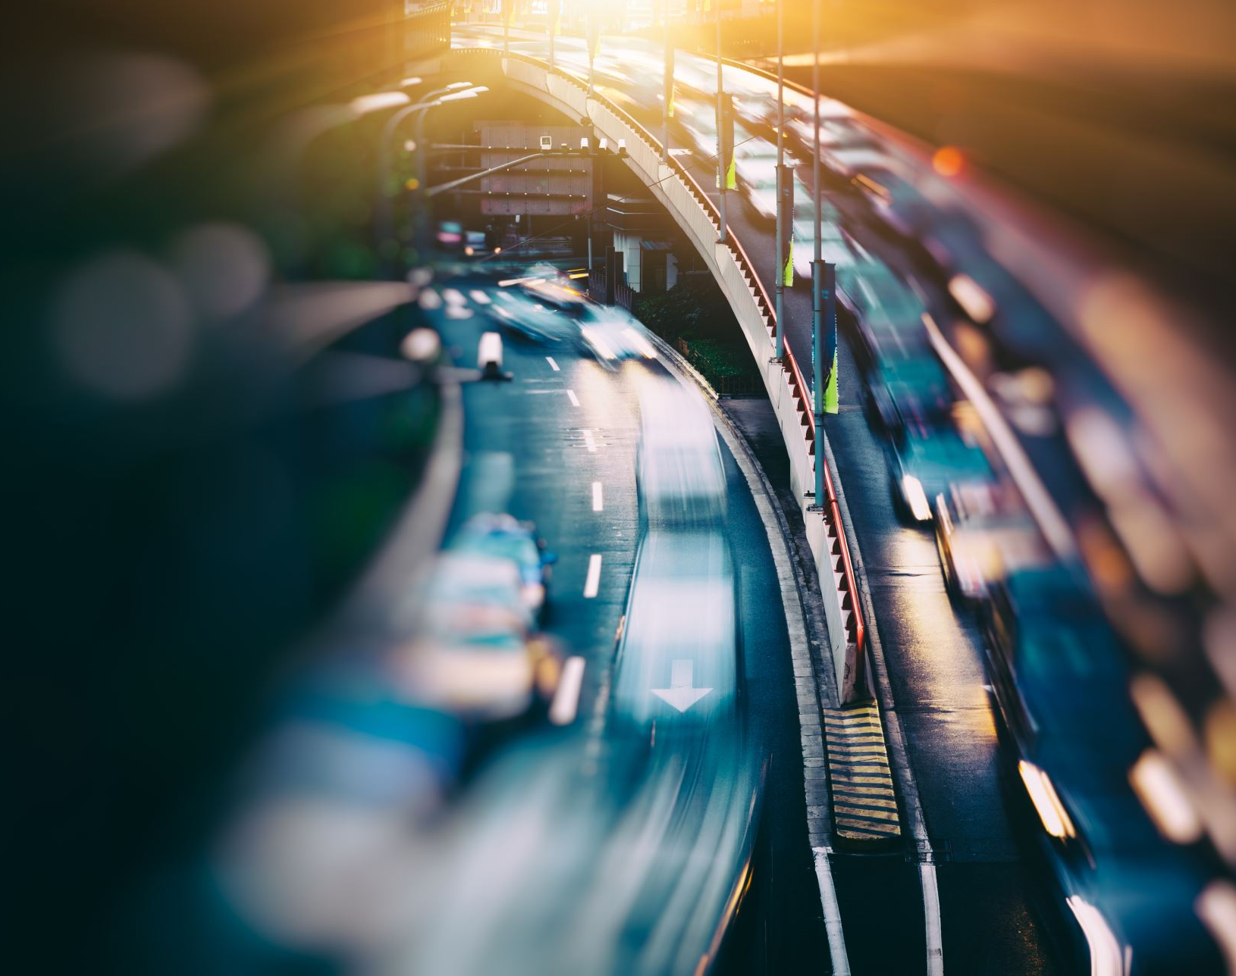
Custom Model with Transfer Learning:
To address overfitting in our custom mode, L2 regularization was implemented
The model's accuracy remained at 39.55%.
Suggests that while overfitting may have been mitigated to some extent, other factors may be contributing to the model's performance.

Slide 14

Custom TSR Performance over epochs

Slide 15
Model Tuning
 |  | Batch Size: 32, Epochs: 50 | Batch Size: 16, Epochs: 50
TSRModel | Validation Accuracy | 88% | 86%
 | Test Accuracy | 84% | 81%
TSRModel_transfer | Validation Accuracy | 87% | 79%
 | Test Accuracy | 39% | 37%

Slide 16
User Interface
Utilized .h5 Format for Storing Trained Models :
A convenient choice for managing large models and facilitating easy sharing and deployment.
Created and Implemented GUI using Tkinter:
A standard Python library used for creating graphical user interfaces (GUIs).

Slide 17

Discussion
Results and Their Implications:
The project demonstrates the effectiveness of deep learning models in traffic sign recognition.
Our custom CNN model outperforms pre-trained models like VGG16, LeNet-5, Inception, and ResNet50, indicating the superiority of tailored models for specialized tasks.
Limitations and Potential Areas for Future Research:
Further evaluation on diverse datasets needed to assess the custom CNN model's generalization capability.
Investigate alternative strategies to improve the performance of ResNet50-based transfer learning in traffic sign recognition.
Explore techniques like pruning and quantization to reduce memory usage and computational requirements of deep learning models for traffic sign recognition.

Slide 18

Conclusion
The results of our project confirm that enhancements in the dataset size and diversity directly contribute to improved accuracy in our custom Traffic Sign Recognition (TSR) model.
Additionally, extending the number of training epochs also positively impacts the model's performance, reinforcing the relationship between extended training and enhanced recognition capabilities.
These findings underscore the potential for further refining our model's accuracy and robustness, suggesting a promising future for more sophisticated traffic sign recognition systems.

Slide 19

Lessons learnt
Model Exploration: Research and experiment with different models to find the most suitable one.
Hyperparameter Tuning: Continuously adjust hyperparameters and increase epochs to optimize model performance.
Data Utilization: Use more data to enhance accuracy, while implementing strategies to prevent overfitting.
Augmentation Balance: Be cautious with data augmentation to avoid negatively affecting accuracy.

Slide 20

References
https://www.kaggle.com/datasets/meowmeowmeowmeowmeow/gtsrb-german-traffic-sign/data
https://medium.com/analytics-vidhya/data-augmentation-techniques-using-opencv-657bcb9cc30b - Image augmentation
https://towardsdatascience.com/complete-image-augmentation-in-opencv-31a6b02694f5 - Augmentation
https://medium.com/@golnaz.hosseini/step-by-step-tutorial-image-classification-with-keras-7dc423f79a6b - CNN model
https://syedabis98.medium.com/hands-on-guide-to-lenet-5-the-complete-info-b2ae631db34b - LetNet-5 Model

Slide 21

THANK YOU

